Slide 1
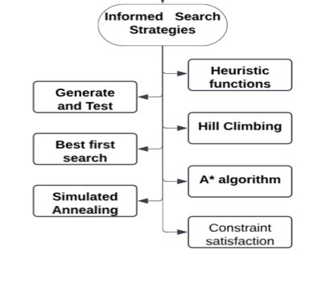
Informed Search Strategies
Uses heuristics to guide search efficiently.
Leverages problem-specific knowledge for solutions.
Estimates cost or distance to goal.
Reduces search space and computation time.
Ideal for complex, large-scale problems.
Eg: Network Routing, Medical Diagnosis

Slide 2
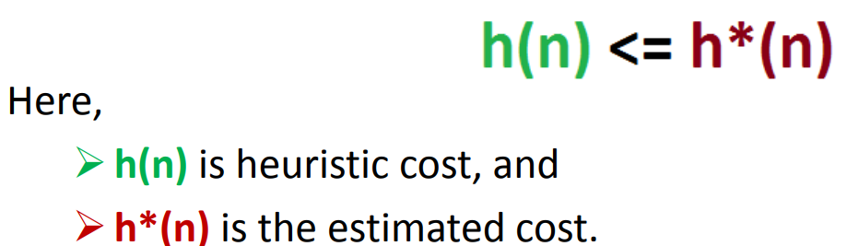
Heuristic functions
Estimates minimal cost from node n
Reduce the search space significantly
Heuristics find good solutions efficiently.
Estimates proximity from current state to goal.
h(n)=Estimated cost from state n to the goal

Slide 3
Heuristic search:
Heuristic search improves search process efficiency.
Sacrifices completeness for better performance.
Heuristics act as problem-solving guides.
Provides good non-optimal solutions quickly.
Handles hard problems in reduced time.
Avoids exponential complexity through heuristics.

Slide 4
Heuristic search
→ Generate-and-test
→ Hill climbing
→ Best-first search
→ Problem reduction
→ Constraint satisfaction

Slide 5
A* Search
A* combines actual and heuristic costs
f(n) = g(n) + h(n)
Prioritizes nodes with lowest total cost.
Balances exploration and exploitation effectively.
Eg: gaming, logistics, network routing

Slide 6
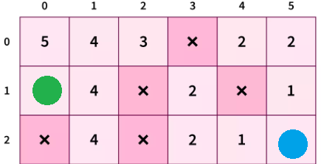
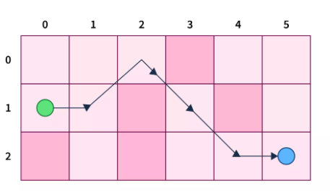
Working of A* Search
Start at source node, initialize lists.
Select node with lowest f(n)
If node is goal, return success.
Generate valid child nodes, add open.
Move selected node to closed list.
Repeat until goal is reached or failure

Slide 7
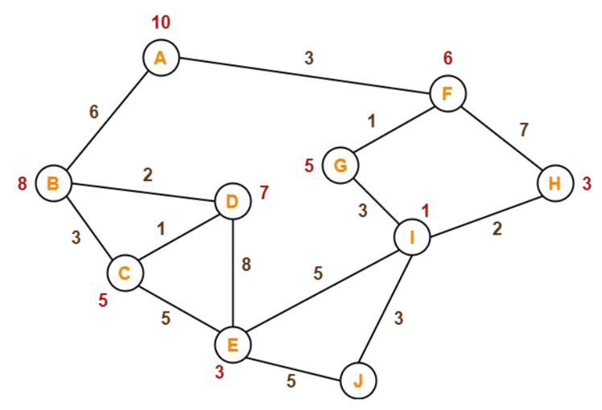
Problem Practice:
Find the path from A to J

Slide 8
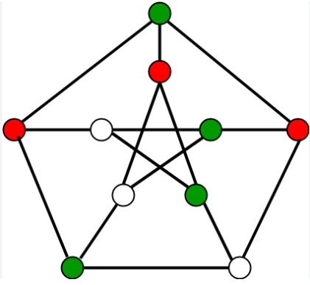
Constraint Satisfaction Problem(CSP)
CSPs involve variables, domains, and constraints.
Variables must be assigned values from domains.
Constraints define valid combinations of values.
Used in puzzle-solving and scheduling problems.
Provides structured framework for problem-solving.
Eg: Sudoku, map coloring, job scheduling

Slide 9
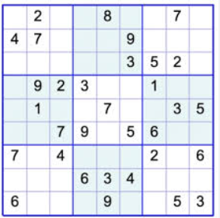
Working of Constraint Satisfaction Problem(CSP)
Define variables, domains, and constraints clearly.
Assign values to variables incrementally.
Check constraints for every assignment made.
Backtrack if constraints are violated.
Continue until all constraints are satisfied.
Return solution or failure if unsolvable

Slide 10
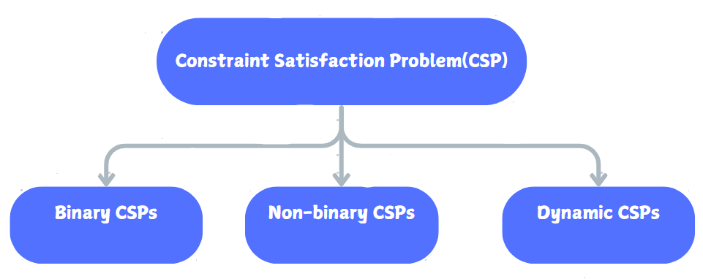
Types of Constraint Satisfaction Problem(CSP)

Slide 11

Binary Constraint Satisfaction Problems(CSPs)
Binary CSPs involve constraints between pairs.
Each constraint connects exactly two variables.
Nodes represent regions; edges are constraints.
No two connected nodes share values.
Easier to visualize and solve problems.
Example: Map coloring with neighboring regions

Slide 12
Non-Binary Constraint Satisfaction Problems(CSPs)
Non-binary CSPs involve multi-variable constraints.
Constraints apply to three or more variables
More complex than binary CSPs overall.
Often decomposed into binary subproblems.
Specialized algorithms handle higher-order constraints.
Example: Scheduling tasks in distinct times.

Slide 13

Basics of Optimization
Optimization is the fundamental process of identifying the best possible solution among all feasible options to achieve a desired outcome.
Objective Function
Types of Optimization
The mathematical expression to be minimised or maximised (e.g., f(x)).
Gradient-Based Methods
Metaheuristics
Finding the 'best' solution often involves balancing multiple factors and constraints.

Slide 14
Gradient-Based Optimization
This method uses the function's gradient (slope) to iteratively move towards a minimum, commonly used in machine learning.
Gradient Descent
Limitation
Update rule: x = x - \alpha * \nabla f(x)
Can become trapped in local minima, preventing discovery of the global optimum.
Moves in the direction of steepest descent.
Used in neural networks and machine learning models.

Slide 15
Metaheuristic Optimization: Beyond Local Minima
Metaheuristics are high-level strategies designed to explore complex solution spaces efficiently, avoiding local minima.
Genetic Algorithm
Particle Swarm Optimization
Simulated Annealing
Inspired by natural selection: initialise population, selection, crossover, mutation, leading to optimal solutions.
Models' social behaviour to find optimal solutions, where particles adjust their paths based on their own and neighbours' best positions.
Inspired by metallurgy, it explores the solution space by accepting worse solutions with a decreasing probability to escape local optima.

